Slide 1
Computer Organization & Design 计算机组成与设计
Weidong Wang (王维东)
wdwang@zju.edu.cn
College of Information Science & Electronic Engineering
信息与通信网络工程研究所（ICAN）
Zhejiang University

Slide 2
Course Information
Instructor: Weidong WANG
Email: wdwang@zju.edu.cn
Tel(O): 0571-87953170;
Office Hours: TBD, Yuquan Campus, Xindian (High-Tech) Building 306, /email whenever
Mobile: 13605812196
TA:
mobile，Email:
孙佳科, 188-8892-3044; 22131087@zju.edu.cn;
Office Hours: Thursday & Saturday 14:00-16:30 PM.
Xindian (High-Tech) Building 308.（也可以短信邮件联系）

Slide 3
Prerequisites预修课程
Logic Design
Programming
C / JAVA / Python
Verilog / OpenCL / C++
Compilers, OS, Circuits/VLSI background is a plus, not needed
How to learn this Course?
Not only listening, thinking and waiting ….
But Exercise, Simulation, Practice!

Slide 4
Other Course Info
Course Text:
David A. Patterson and John L. Hennessy, Computer Organization & Design: The Hardware/Software Interface, 5th edition,机械工业出版社，2014→2019
“Green card” summarizes MIPS ISA→RISC-V
Website:
课程教学网站：浙江大学“学在浙大” 平台
http://mypage.zju.edu.cn/wdwd/
Check frequently
Classroom
玉泉教7-108 周四Thursday –六七八节

Slide 5
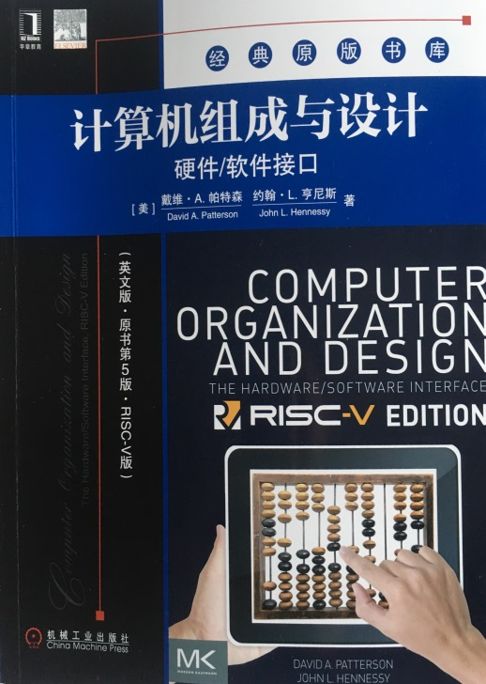
Textbook Info
Textbook
Computer Organization and Design (The HW/SW Interface) RISC-V Edition， D. Patterson & J. Hennessy, 英文版，原书第5版，RISC-V版，机械工业出版社，2019
“Green card” summarizes RISC-V ISA

Slide 6
Grading (Tentative)
Final grades will be computed approximately as follows:
理论课成绩100分（COD） ：
Homework Sets - 10%
Homework Sets （10%）
Quizes - 10%
2~4次 Quizes（随堂小测）
Two Projects and discussion - 10%
2 projects (1 or 2 members team)
Web 网络线上学习+线上测验：30%。
Finial Exam - 40%（闭卷，英文题目，答卷中英文不限）
实验课：100分
总评最后成绩: =Lab score * (0.5/3.5) + COD * (3.0/3.5)
Notes:
上课说明此门课程的成绩合成：平时成绩包括平时小测验、期中考试、作业、出勤、课堂讨论、论文

Slide 7
Lecture 15 Review
7

Slide 8
Major Topics
Hardware-software interface
Machine language and assembly language programming
Compiler optimizations and performance
Processor design
Pipelined processor design
Memory hierarchy design
Caches
I/O devices and systems
Virtual memory & operating systems support
Multiprocessors and Multithreading

Slide 9
Why take this class?
9
Learn how modern computing hardware works
Understand where computing hardware is going in the future
And learn how to contribute to this future…
How does this impact system software and applications?
Essential to understand OS/compilers/PL
For everyone else, it can help you write better code!
How are future technologies going to impact computing systems?
Notes:
我们许多人认为自己是搞硬件的，有人认为是搞软件的。这种说法暗示你对某一方面精通，而对另一方面知之甚少。听起来好像软件与硬件间有一堵高墙，你选择呆在墙的某一边。现在开始你要抛弃这个观念。

Slide 10
Topics of Study
Focus on what modern computer architects worry about ( both academia and industry)
Get through the basics of modern processor design
Look at technology trends: multithreading, CMP,
power-, reliability- and security- aware design
Recent research ideas, and the future of computing hardware
10

Slide 11
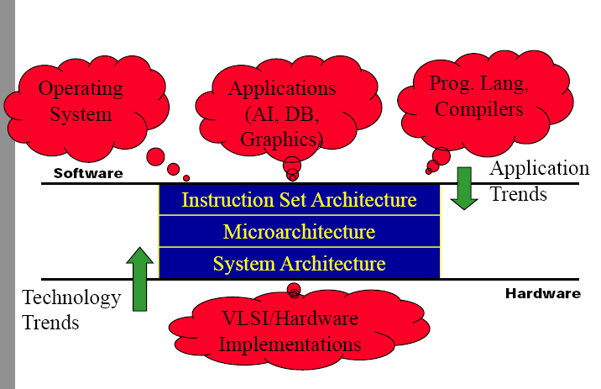
What is Computer Architecture?

Slide 12
5 components of any Computer
Computer
Keyboard, Mouse
Processor
Memory
(where
programs,
data
live when
running)
Devices
Disk (where
programs,
data
live when
not running)
Control
(“brain”)
Input
Datapath
(“brawn”)
Output
Display, Printer

Slide 13
Abstraction Layers in Modern Systems
Application
Algorithm
Programming Language
Parallel computing, security, …
Original domain of the computer architect („50s-‟80s)
Operating System/Virtual Machines
Instruction Set Architecture (ISA)
Domain of recent computer architecture
(„90s)
Microarchitecture
Gates/Register-Transfer Level (RTL)
Reliability, power, …
Circuits
Devices
Physics
Reinvigoration of computer architecture, mid-2000s onward.

Slide 14


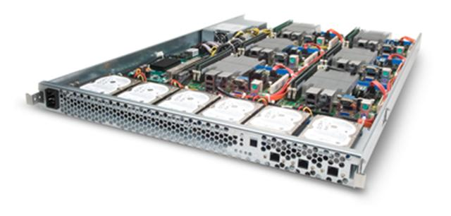
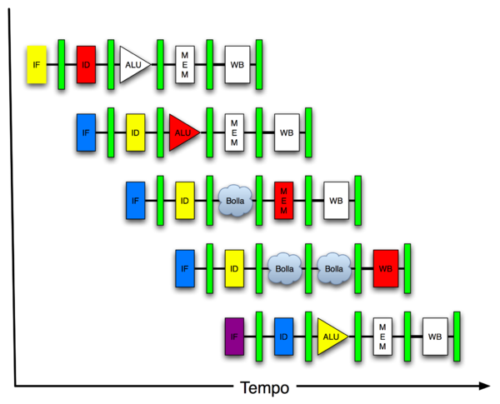
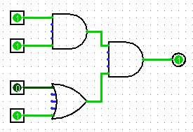
Machine Structures
Software Hardware
Parallel Requests
Assigned to computer
e.g., Search “Cats”
Parallel Threads
Assigned to core
e.g., Lookup, Ads
Parallel Instructions
>1 instruction @ one time
e.g., 5 pipelined instructions
Parallel Data
>1 data item @ one time
e.g., Add of 4 pairs of words
Hardware descriptions
All gates working in parallel at same time
Warehouse Scale Computer
Smart Phone
Harness Parallelism &
Achieve High Performance
Computer
Core
…
Core
Memory (Cache)
Input/Output
Core
Today’s Lecture
Instruction Unit(s)
Functional
Unit(s)
A₀+B₀
A₁+B₁
A₂+B₂
A₃+B₃
Main Memory
Logic Gates

Slide 15
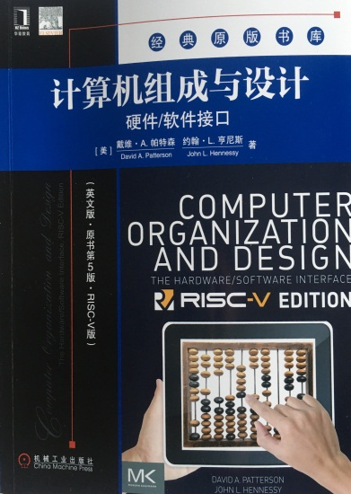
Lecture 2 Introduction to RISC-V Assembly language: Arithmetic

Slide 16
Aside: Registers are Inside the Processor
Processor
Memory
Input
Control
Enable?
Read/Write
Program
Datapath
Address
PC
Bytes
Registers
Write Data
Data
Arithmetic & Logic Unit
(ALU)
Read Data
Output
Processor-Memory Interface
I/O-Memory Interfaces

Slide 17
And in Conclusion…
In RISC-V Assembly Language:
Registers replace C variables
One instruction (simple operation) per line
Simpler is Better, Smaller is Faster
In RV32, words are 32b
Instructions:
add, addi, sub
Registers:
32 registers, referred to as x0 – x31
Zero: x0

Slide 18
Big Endian vs. Little Endian
Big-endian and little-endian derive from Jonathan Swift's Gulliver's Travels《格列佛游记》 in which the Big Endians were a political faction that broke their eggs at the large end ("the primitive way") and rebelled against the Lilliputian King who required his subjects (the Little Endians) to break their eggs at the small end.
The order in which BYTES are stored in memory
Bits always stored as usual. (E.g., 0xC2=0b 1100 0010)
Consider the number 1025 as we normally write it: BYTE3 BYTE2 BYTE1 BYTE0 00000000 00000000 00000100 00000001
Big Endian
ADDR3 ADDR2 ADDR1 ADDR0 BYTE0 BYTE1 BYTE2 BYTE3 00000001 00000100 00000000 00000000
Examples
Names in China (e.g., Garcia Dan)
Java Packages: (e.g., org.mypackage.HelloWorld)
Dates done correctly ISO 8601 YYYY-MM-DD (e.g., 2019-08-16)
Eating Pizza crust first
Unix file structure (e.g., /usr/local/bin/python)
Little Endian
ADDR3 ADDR2 ADDR1 ADDR0 BYTE3 BYTE2 BYTE1 BYTE0 00000000 00000000 00000100 00000001
Examples
Names in the US (e.g., Dan Garcia)
Internet names (e.g., www.cs.berkeley.edu)
Dates written in England DD/MM/YYYY (e.g., 16/08/2019)
Eating Pizza skinny part first (the normal way)
en.wikipedia.org/wiki/Big_endian

Slide 19
And in Conclusion…
Memory is byte-addressable, but lw and sw access one word at a time.
A pointer (used by lw and sw) is just a memory address, we can add to it or subtract from it (using offset).
A Decision allows us to decide what to execute at run-time rather than compile-time.
C Decisions are made using conditional statements within if, while, do while, for.
RISC-V Decision making instructions are the conditional branches: beq and bne.
New Instructions:
lw, sw, lb, sb, lbu, beq, bne, blt, bltu, bge, j

Slide 20
And in Conclusion…
Registers we know so far (Most of them!)
a0-a7 for function arguments, a0-a1 for return values
ra return address
s0-s11 saved registers
zero
Instructions we know:
Arithmetic: add, addi, sub
Logical: sll, srl, sla, slli, srli, slai, and, or, xor, andi, ori, xori
Decision: beq, bne, blt, bge
Unconditional branches (jumps): j, jr
Functions called with jal, return with jr ra.

Slide 21
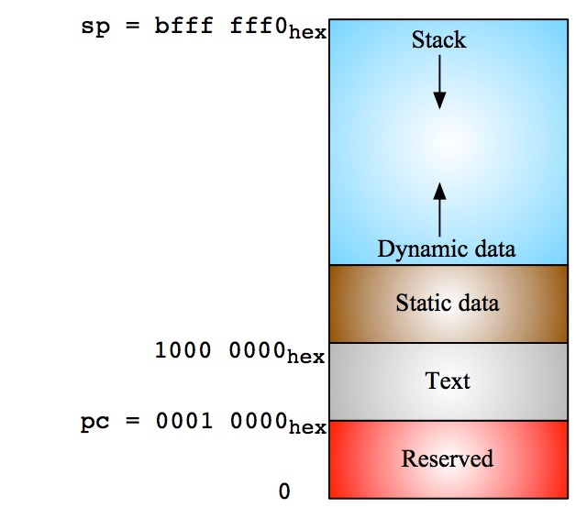
RV32 Memory Allocation

Slide 22
And in Conclusion…
Registers we know so far (All of them!)
a0-a7 for function arguments, a0-a1 for return values
sp, stack pointer, ra return address
s0-s11 saved registers
t0-t6 temporaries
zero
Instructions we know:
Arithmetic: add, addi, sub
Logical: sll, srl, sla, slli, srli, slai, and, or, xor, andi, ori, xori
Decision: beq, bne, blt, bge
Unconditional branches (jumps): j, jr
Functions called with jal, return with jr ra.
The stack is your friend: Use it to save anything you need. Just leave it the way you found it!

Slide 23
Salient Features of MIPS I
32-bit fixed format inst (3 formats)
32 32-bit GPR (R0 contains zero) and 32 FP registers (and HI LO)
partitioned by software convention
3-address, reg-reg arithmetic instr.
Single address mode for load/store: base+displacement
no indirection, scaled
16-bit immediate plus LUI
Simple branch conditions
compare against zero or two registers for =,≠
no integer condition codes
Delayed branch
execute instruction after a branch (or jump) even if the branch is taken (Compiler can fill a delayed branch with useful work about 50% of the time)

Slide 24
R-Format Instruction Layout
Field’s bit positions
31
25
24
20
19
15
14
12
11
7
6
0
funct7
rs2
rs1
funct3
rd
opcode
7
5
5
3
5
7
Name of field
Number of bits in field
32-bit instruction word divided into six fields of varying numbers of bits each: 7+5+5+3+5+7 = 32
Examples
opcode is a 7-bit field that lives in bits 6-0 of the instruction
rs2 is a 5-bit field that lives in bits 24-20 of the instruction

Slide 25
All RV32 R-format instructions
0000000
rs2
rs1
000
rd
0110011
add
0100000
rs2
rs1
000
rd
0110011
sub
0000000
rs2
rs1
001
rd
0110011
sll
0000000
rs2
rs1
010
rd
0110011
slt
0000000
rs2
rs1
011
rd
0110011
sltu
0000000
rs2
rs1
100
rd
0110011
xor
0000000
rs2
rs1
101
rd
0110011
srl
0100000
rs2
rs1
101
rd
0110011
sra
0000000
rs2
rs1
110
rd
0110011
or
0000000
rs2
rs1
111
rd
0110011
and
Different encoding in funct7 + funct3 selects different operations
Can you spot two new instructions?

Slide 26
I-Format Instruction Layout
31
25
24
20
19
15
14
12
11
7
6
0
funct7
Imm[11:0]
rs1
funct3
rd
opcode
rs2
7
12
5
5
3
5
7
Only one field is different from R-format, rs2 and funct7 replaced by 12-bit signed immediate, imm[11:0]
Remaining fields (rs1, funct3, rd, opcode) same as before
imm[11:0] can hold values in range [-2048_{ten} , +2047_{ten} ]
Immediate is always sign-extended to 32-bits before use in an arithmetic operation
We’ll later see how to handle immediates > 12 bits

Slide 27
All RV32 I-format Arithmetic Instructions
imm[11:0]
rs1
000
rd
0010011
addi
imm[11:0]
rs1
010
rd
0010011
slti
imm[11:0]
rs1
011
rd
0010011
sltiu
imm[11:0]
rs1
100
rd
0010011
xori
imm[11:0]
rs1
110
rd
0010011
ori
imm[11:0]
rs1
111
rd
0010011
andi
0000000
shamt
rs1
001
rd
0010011
slli
0000000
shamt
rs1
101
rd
0010011
srli
0100000
shamt
rs1
101
rd
0010011
srai
One of the higher-order immediate bits is used to distinguish “shift right logical” (SRLI) from “shift right arithmetic” (SRAI)
“Shift-by-immediate” instructions only use lower 5 bits of the immediate value for shift amount (can only shift by 0-31 bit positions)

Slide 28
All RV32 Load Instructions
imm[11:0]
rs1
000
rd
0000011
lb
imm[11:0]
rs1
010
rd
0000011
lh
imm[11:0]
rs1
011
rd
0000011
lw
imm[11:0]
rs1
100
rd
0000011
lbu
imm[11:0]
rs1
110
rd
0000011
lhu
funct3 field encodes size and ‘signedness’ of load data
LBU is “load unsigned byte”
LH is “load halfword”, which loads 16 bits (2 bytes) and sign-extends to fill destination 32-bit register
LHU is “load unsigned halfword”, which zero-extends 16 bits to fill destination 32-bit register
There is no LWU in RV32, because there is no sign/zero extension needed when copying 32 bits from a memory location into a 32-bit register

Slide 29
S-Format Used for Stores
31
25
24
20
19
15
14
12
11
7
6
0
Imm[11:5]
rs2
rs1
funct3
imm[4:0]
opcode
7
5
5
3
5
7
offset[11:5]
src
base
width
offset[4:0]
STORE
Store needs to read two registers, rs1 for base memory address, and rs2 for data to be stored, as well immediate offset!
Can’t have both rs2 and immediate in same place as other instructions!
Note that stores don’t write a value to the register file, no rd!
RISC-V design decision is move low 5 bits of immediate to where rd field was in other instructions – keep rs1/rs2 fields in same place
register names more critical than immediate bits in hardware design

Slide 30
All RV32 Store Instructions
Imm[11:5]
rs2
rs1
000
imm[4:0]
0100011
sb
Imm[11:5]
rs2
rs1
001
imm[4:0]
0100011
sh
Imm[11:5]
rs2
rs1
010
imm[4:0]
0100011
sw
width
Store byte, halfword, word

Slide 31
RISC-V B-Format for Branches
31
30
25
24
20
19
15
14
12
11
8
7
6
0
imm[12]
imm[10:5]
rs2
rs1
funct3
imm[4:1]
imm[11]
opcode
1
6
5
5
3
4
1
7
offset[12|10:5]
rs2
rs1
funct3
offset[4:1|11]
BRANCH
B-format is mostly same as S-Format, with two register sources (rs1/rs2) and a 12-bit immediate imm[12:1]
But now immediate represents values -4096 to +4094 in 2-byte increments
The 12 immediate bits encode even 13-bit signed byte offsets (lowest bit of offset is always zero, so no need to store it)

Slide 32
RISC-V Immediate Encoding
Instruction encodings, inst[31:0]
31
30
25
24
20
19
15
14
12
11
8
7
6
0
funct7
rs2
rs1
funct3
rd
opcode
R-type
imm[11:0]
rs1
funct3
rd
opcode
I-type
imm[11:5]
rs2
rs1
funct3
imm[4:0]
opcode
S-type
imm[12|10:5]
rs2
rs1
funct3
imm[4:1|11]
opcode
B-type
32-bit immediates produced, imm[31:0]
31
25
24
12
11
10
5
4
1
0
-inst[31]-
inst[30:25]
inst[24:21]
inst[20]
I-imm.
-inst[31]-
inst[30:25]
inst[11:8]
inst[7]
S-imm.
-inst[31]-
inst[7]
inst[30:25]
inst[11:8]
0
B-imm.
Upper bits sign-extended from inst[31] always
Only bit 7 of instruction changes role in immediate between S and B

Slide 33
All RISC-V Branch Instructions
imm[12|10:5]
rs2
rs1
000
imm[4:1|11]
1100011
BEQ
imm[12|10:5]
rs2
rs1
001
imm[4:1|11]
1100011
BNE
imm[12|10:5]
rs2
rs1
100
imm[4:1|11]
1100011
BLT
imm[12|10:5]
rs2
rs1
101
imm[4:1|11]
1100011
BGE
imm[12|10:5]
rs2
rs1
110
imm[4:1|11]
1100011
BLTU
imm[12|10:5]
rs2
rs1
111
imm[4:1|11]
1100011
BGEU

Slide 34
U-Format for “Upper Immediate” Instructions
31
12
11
7
6
0
imm[31:12]
rd
opcode
20
5
7
U-immediate[31:12]
dest
LUI
U-immediate[31:12]
dest
AUIPC
Has 20-bit immediate in upper 20 bits of 32-bit instruction word
One destination register, rd
Used for two instructions
LUI – Load Upper Immediate
AUIPC – Add Upper Immediate to PC

Slide 35
J-Format for Jump Instructions
31
30
21
20
19
12
11
7
6
0
imm[20]
imm[10:1]
imm[11]
imm[19:12]
rd
opcode
1
10
1
8
5
7
offset[20:1]
dest
JAL
JAL saves PC+4 in register rd (the return address)
Assembler “j” jump is pseudo-instruction, uses JAL but sets rd=x0 to discard return address
Set PC = PC + offset (PC-relative jump)
Target somewhere within ±2¹⁹ locations, 2 bytes apart
±2¹⁸ 32-bit instructions
Immediate encoding optimized similarly to branch instruction to reduce hardware cost

Slide 36
JALR Instruction (I-Format)
31
20
19
15
14
12
11
7
6
0
imm[11:0]
rs1
func3
rd
opcode
12
5
3
5
7
offset[11:0]
base
0
dest
JALR
JALR rd, rs, immediate
Writes PC+4 to rd (return address)
Sets PC = rs + immediate
Uses same immediates as arithmetic and loads
no multiplication by 2 bytes
In contrast to branches and JAL

Slide 37
Summary of RISC-V Instruction Formats
31
30
25
24
21
20
19
15
14
12
11
8
7
6
0
funct7
rs2
rs1
funct3
rd
opcode
R-type
imm[11:0]
rs1
funct3
rd
opcode
I-type
imm[11:5]
rs2
rs1
funct3
imm[4:0]
opcode
S-type
imm[12|10:5]
rs2
rs1
funct3
imm[4:1|11]
opcode
B-type
imm[31:12]
rd
opcode
U-type
imm[20|10:1|11]]
imm[19:12]
rd
opcode
J-type

Slide 38
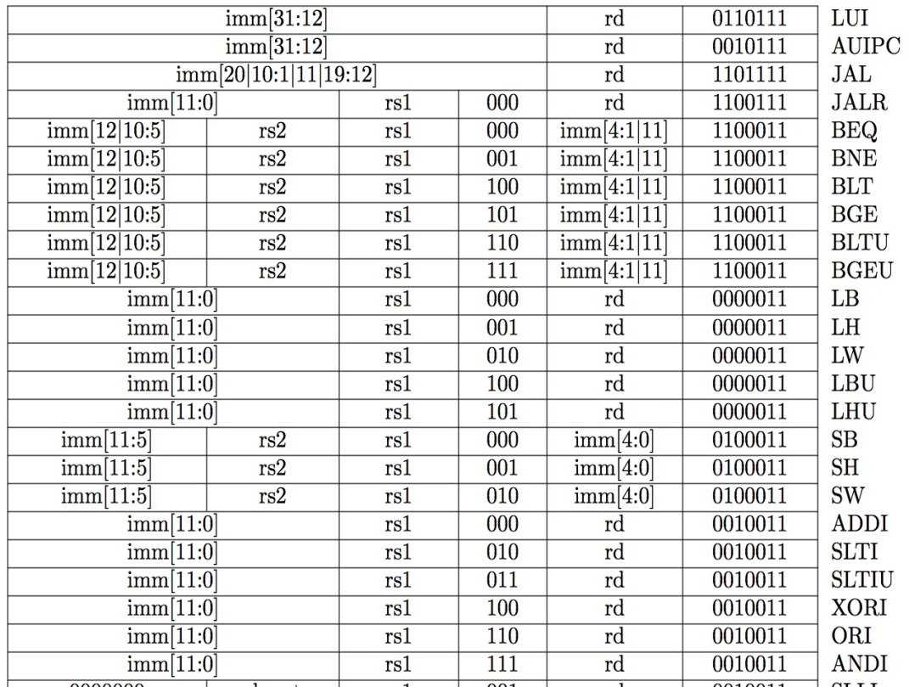
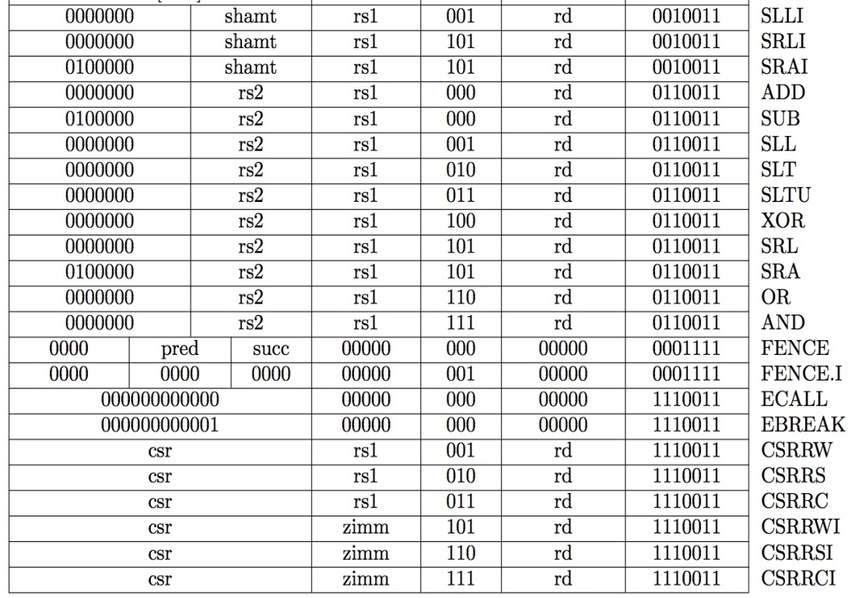
Complete RV32I ISA
Not in 2022

Slide 39
Lecture 4 Performance, Energy & Compiler

Slide 40
Computer Performance Metrics
Response Time (latency延迟 )
How long does it take for my job to run?
How long does it take to execute a job?
How long must I wait for the database query?
Throughput吞吐量
How many jobs can the machine run at once?
What is the average execution rate?
How many queries per minute?
If we upgrade a machine with a new processor what to we increase?
If we add a new machine to the lab what do we increase?

Slide 41
Performance = Execution Time
Elapsed Time
Counts everything (disk and memory accesses, I/O, etc.)
A useful number, but often not good for comparison purposes
E.g., OS & multiprogramming time make it difficult to compare CPUs
CPU time (CPU = Central Processing Unit = processor)
Doesn’t count I/O or time spent running other programs
Can be broken up into system time, and user time
Our focus: user CPU time
Time spent executing the lines of code that are “in” our program
Includes arithmetic, memory, and control instructions, …

Slide 42
Clock Cycles
Instead of reporting execution time in seconds, we often use cycles
Clock “ticks” indicate when to start activities
Cycle time = time between ticks = seconds per cycle
Clock rate (frequency) = cycles per second (1Hz. = 1cycle/sec)
A 2GHz clock has a 500 picoseconds (ps) cycle time.

Slide 43
Performance and Execution Time
The program should be something real people care about
Desktop: MS office, edit, compile
Server: web, e-commerce, database
Scientific: physics, weather forecasting

Slide 44
Measuring Clock Cycles
Clock cycles/program is not an intuitive or easily determined value, so
Clock Cycles = Instructions x Clock Cycles Per Instruction
Cycles Per Instruction (CPI) used often
CPI is an average since the number of cycles per instruction varies from instruction to instruction
Average depends on instruction mix, latency of each inst. Type etc.
CPIs can be used to compare two implementations of the same ISA, but is not useful alone for comparing different ISAs
An X86 add is different from a MIPS add

Slide 45
Using CPI
Drawing on the previous equation:
To improve performance (i.e. reduce execution time)
Increase clock rate (decrease clock cycle time) OR
Decrease CPI OR
Reduce the number of instructions
Designers balance cycle time against the number of cycles required
Improving one factor may make the other one worse

Slide 46
Speedup
Speedup allows us to compare different CPUs or optimizations
Example
Original CPU takes 2 seconds to run a program
New CPU takes 1.5 seconds to run a program
Speedup = 1.333 or speedup or 33%

Slide 47
Amdahl’s Law
If an optimization improves a fraction f of execution time by a factor of a
This formula is known as Amdahl’s Law
Lessons from
If f->100%, then speedup = a
If a->∞, the speedup = 1/(1-f)
Summary
Make the common case fast
Watch out for the non-optimized component

Slide 48
Procedure Call and Return
Procedures are required for structured programming
Aka: functions, methods, subroutines, …
Implementing procedures in assembly requires several things to be done
Memory space must be set aside for local variables
Arguments must be passed in and return values passed out
Execution must continue after the call
Procedure Call Steps
1. Place parameters in a place where the procedure can access them
2. Transfer control to the procedure
3. Acquire the storage resources needed for the procedure
4. Perform the desired task
5. Place the result value in a place where the calling program can access it
6. Return control to the point of origin

Slide 49
Call and Return
To jump to a procedure, use the jal or jalr instructions
jal target # Jump and link to label
jalr $dest # Jump and link to $dest
Jump and link
The program counter (PC) stores the address of the currently executing instruction
The “jump and link” instructions stores the next instruction address in $ra before transferring control to the target/destination
Therefore, the address stored in $ra is PC + 4
To return, use the jr instruction
jr $ra

Slide 50
Lecture 5 RISC-V Datapath

Slide 51
One-Instruction-Per-Cycle RISC-V Machine
On every tick of the clock, the computer executes one instruction
Current state outputs drive the inputs to the combinational logic, whose outputs settles at the values of the state before the next clock edge
At the rising clock edge, all the state elements are updated with the combinational logic outputs, and execution moves to the next clock cycle
pc
Combinational Logic
clock
IMEM
Reg[]
DMEM

Slide 52
Basic Phases of Instruction Execution
rd
PC
IMEM
rs1
Reg[ ]
DMEM
rs2
ALU
+4
imm
mux
2. Decode/
Register
Read
1. Instruction
Fetch
3. Execute
5. Register
Write
4. Memory
Clock
time

Slide 53
Recap: Complete RV32I ISA
Not in 2022
RV32I has 47 instructions
37 instructions are enough to run any C program

Slide 54
Complete RV32I Datapath!
+4
Add
Add
wb
pc
pc+4
2
DataD
Reg[rs1]
alu
1
alu
1
Inst[11:7]
0
wb
PC
addr
AddrD
1
0
addr
Inst[19:15]
DataR
inst
DataA
alu
pc+4
inst
AddrA
Branch
Comp
0
+
addr
mem
Inst[24:20]
AddrB
DataB
ALU
clk
0
DataW
IMEM
IMEM
Reg [ ]
1
DMEM
Inst [31:7]
clk
Reg[rs2]
clk
Imm.
Gen
Imm[31:0]
PCSel
Inst[31:0]
ImmSel
RegWEn
BrUn
BrLT
Bsel
ALUSel
MemRW
WBSel
Control logic
Asel
Control logic
BrEq

Slide 55
Recap
We have designed a complete datapath
Capable of executing all RISC-V instructions in one cycle each
Not all units (hardware) used by all instructions
5 Phases of execution
IF, ID, EX, MEM, WB
Not all instructions are active in all phases
Controller specifies how to execute instructions
New instructions can be added with just control?

Slide 56
Lecture 6 RISC-V Control

Slide 57
Single-Cycle RV32I Datapath and Control
+4
Add
Add
pc+4
2
DataD
Reg[rs1]
1
1
Inst[11:7]
AddrD
0
wb
PC
addr
1
0
addr
Inst[19:15]
DataR
inst
DataA
alu
pc+4
inst
AddrA
Branch
Comp
0
+
addr
mem
Inst[24:20]
AddrB
DataB
ALU
clk
0
DataW
IMEM
IMEM
Reg [ ]
1
DMEM
Inst [31:20]
clk
Reg[rs2]
clk
Imm.
Gen
Imm[31:0]
PCSel
Inst[31:0]
ImmSel
RegWEn
BrUn
BrLT
Bsel
ALUSel
MemRW
WBSel
Control logic
Asel
Control logic
BrEq

Slide 58
ROM-based Control
11-bit address (inputs)
Inst[30,14:12,6:2]
BrEq
BrLT
9
PCSel
ROM
3
ImmSel[2:0]
BrUn
ASel
BSel
4
ALUSel[3:0]
MemRW
RegWEn
2
WBSel[1:0]
15 data bits (outputs)

Slide 59
ROM Controller Implementation
AND
OR
add
Control Word for add
Control Word for sub
Control Word for or
.
.
.
sub
or
Address
Decoder
Inst[]
BrEQ
BrLT
11
.
.
.
jal
Controller output (PCSel, ImmSel, …)

Slide 60
Lecture 7 RISC-V Pipeline

Slide 61
Pipelining Lessons (1/2)
6 PM
7
8
9
Pipelining doesn’t help latency of single task, it helps throughput of entire workload
Multiple tasks operating simultaneously using different resources
Potential speedup = Number pipe stages
Time to “fill” pipeline and time to “drain” it reduces speedup: 2.3X v. 4X in this example
Time
T
a
s
k
O
r
d
e
r
30
30
30
30
30
30
30
A
B
C
D

Slide 62



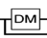
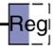

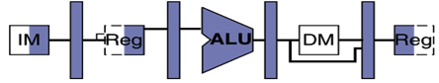
Pipelining with RISC-V
Phase | Pictogram | t_{step} Serial
Instruction Fetch |  | 200 ps
Reg Read |  | 100 ps
ALU |  | 200 ps
Memory |  | 200 ps
Register Write |  | 100 ps
t_{instruction} |  | 800 ps
t_{cycle} Pipelined
200 ps
200 ps
200 ps
200 ps
200 ps
1000 ps
t_{instruction}
add t0, t1, t2
instruction sequence
or t3, t4, t5
sll t6, t0, t3
t_{cycle}
Notes:
Tc = “Time between completion of instructions”

Slide 63
Sequential vs Simultaneous
What happens sequentially, what happens simultaneously?
t_{instruction} = 1000 ps
add t0, t1, t2
or t3, t4, t5
sll t6, t0, t3
instruction sequence
sw t0, 4(t3)
lw t0, 8(t3)
t_{cycle}
= 200 ps
addi t2, t2, 1
Notes:
Tc = “Time between completion of instructions”

Slide 64
Each stage operates on different instruction
lw t0, 8(t3)
sw t0, 4(t3)
slt t6, t0, t3
or t3, t4, t5
add t0, t1, t2
pc_{X}
pc_{M}
pc_{F}
pc_{D}
+4
+4
Reg[]
rs1_{X}
1
DataD
ALU
DMEM
alu_{X}
0
AddrD
Branch Comp.
alu_{M}
Addr
DataR
pc_{F}+4
IMEM
AddrA
DataA
DataW
AddrB
DataB
inst_{D}
rs2_{X}
rs2_{M}
Imm.
imm_{X}
inst_{X}
inst_{M}
inst_{W}
Pipeline registers separate stages, hold data for each instruction in flight

Slide 65
Pipelining Hazards
A hazard is a situation that prevents starting the next instruction in the next clock cycle
Structural hazard
A required resource is busy (e.g. needed in multiple stages)
Data hazard
Data dependency between instructions
Need to wait for previous instruction to complete its data read/write
Control hazard
Flow of execution depends on previous instruction

Slide 66
Structural Hazard: Memory Access
Instruction and data memory used simultaneously
Use two separate memories
add t0, t1, t2
or t3, t4, t5
slt t6, t0, t3
instruction sequence
sw t0, 4(t3)
lw t0, 8(t3)

Slide 67
Structural Hazards – Summary
Conflict for use of a resource
In RISC-V pipeline with a single memory
Load/store requires data access
Without separate memories, instruction fetch would have to stall for that cycle
All other operations in pipeline would have to wait
Pipelined datapaths require separate instruction/data memories
Or separate instruction/data caches
RISC ISAs (including RISC-V) designed to avoid structural hazards
e.g. at most one memory access/instruction

Slide 68
Data Hazard: ALU Result
Value of s0
5 | 5 | 5 | 5 | 5/9 | 9 | 9 | 9 | 9
add s0, t0, t1
sub t2, s0, t0
or t6, s0, t3
instruction sequence
xor t5, t1, s0
sw s0, 8(t3)
Without some fix, sub and or will calculate wrong result!

Slide 69
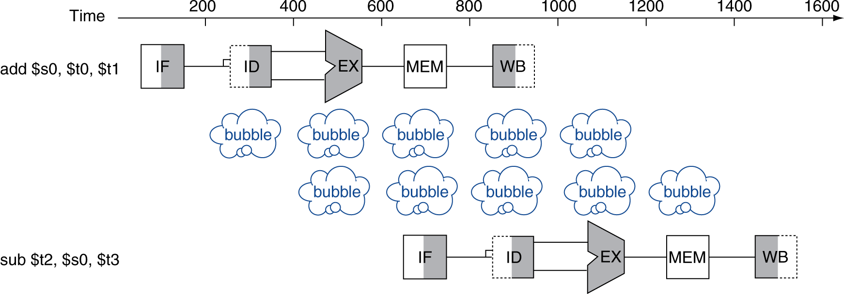
Solution 1: Stalling小隔间
Problem: Instruction depends on result from previous instruction
add s0, t0, t1 sub t2, s0, t3
Bubble气泡:
effectively NOP: affected pipeline stages do “nothing”

Slide 70
Solution 2: Forwarding转发
Value of t0
5 | 5 | 5 | 5 | 5/9 | 9 | 9 | 9 | 9
add t0, t1, t2
or t3, t0, t5
sub t6, t0, t3
instruction sequence
xor t5, t1, t0
sw t0, 8(t3)
Forwarding: grab operand from pipeline stage,
rather than register file

Slide 71
Forwarding Path
pc_{X}
pc_{M}
pc_{F}
pc_{D}
+4
+4
Reg[]
rs1_{X}
1
DataD
ALU
DMEM
alu_{X}
0
AddrD
Branch Comp.
alu_{M}
Addr
DataR
pc_{F}+4
IMEM
AddrA
DataA
DataW
AddrB
DataB
inst_{D}
rs2_{X}
rs2_{M}
Imm.
imm_{X}
inst_{X}
inst_{M}
inst_{W}
Forwarding Control Logic

Slide 72
Control Hazards
beq t0, t1, label
sub t2, s0, t5
executed regardless of branch outcome!结果
executed regardless of branch outcome!!!
or t6, s0, t3
PC updated reflecting branch outcome
xor t5, t1, s0
sw s0, 8(t3)

Slide 73
Increasing Processor Performance
Clock rate
Limited by technology and power dissipation
Pipelining
“Overlap” instruction execution
Deeper pipeline: 5 => 10 => 15 stages
Less work per stage → shorter clock cycle
But more potential for hazards (CPI > 1)
Multi-issue “superscalar” processor

Slide 74
Lecture 8 Floating Point

Slide 75
Floating Point Representation (1/2)
Normal format: +1.xxx…x_{two}*2^{yyy…y}two
Multiple of Word Size (32 bits)
31
30
23
22
0
S
Exponent
Significand
1 bit
8 bits
23 bits
S represents Sign Exponent represents y’s Significand represents x’s
Represent numbers as small as 2.0 x 10⁻³⁸ to as large as 2.0 x 10³⁸

Slide 76
IEEE 754 Floating Point Standard (1/3)
Single Precision (DP similar):
Sign bit:1 means negative, 0 means positive
Significand:
To pack more bits, leading 1 implicit for normalized numbers
1 + 23 bits single, 1 + 52 bits double
always true: 0 < Significand < 1 (for normalized numbers)
Note: 0 has no leading 1, so reserve exponent value 0 just for number 0
31
30
23
22
0
S
Exponent
Significand
1 bit
8 bits
23 bits

Slide 77
IEEE 754 Floating Point Standard (3/3)
Called Biased Notation, where bias is number subtracted to get real number
IEEE 754 uses bias of 127 for single prec.
Subtract 127 from Exponent field to get actual value for exponent
1023 is bias for double precision
Summary (single precision, or fp32):
31
30
23
22
0
S
Exponent
Significand
1 bit
8 bits
23 bits
(-1)^{S} x (1 + Significand) x 2^{(Exponent-127)}
Double precision identical, except with exponent bias of 1023 (half, quad similar)

Slide 78
Representation for ± ∞
In FP, divide by 0 should produce ± ∞, not overflow.
Why?
OK to do further computations with ∞ E.g., X/0 > Y may be a valid comparison
Ask math majors
IEEE 754 represents ± ∞
Most positive exponent指数reserved for ∞
Significands尾数all zeroes

Slide 79
Special Numbers
What have we defined so far? (Single Precision)
Exponent Significand Object
0 0 0
0 nonzero ???
1-254 anything +/- fl. pt. #
255 0 +/- ∞
255 nonzero ???

Slide 80
Conclusion
Exponent tells Significand how much (2^{i}) to count by (…, 1/4, 1/2, 1, 2, …)
Floating Point lets us:
Represent numbers containing both integer and fractional parts; makes efficient use of available bits.
Store approximate values for very large and very small #s.
IEEE 754 Floating Point Standard is most widely accepted attempt to standardize interpretation of such numbers (Every desktop or server computer sold since ~1997 follows these conventions)
Can store NaN, ± ∞
Summary (single precision):
31
30
23
22
0
S
Exponent
Significand
1 bit
8 bits
23 bits
(-1)^{S} x (1 + Significand) x 2^{(Exponent-127)}
Double precision identical, except with exponent bias of 1023 (half, quad similar)

Slide 81
Lecture 9 Memory System: Cache

Slide 82
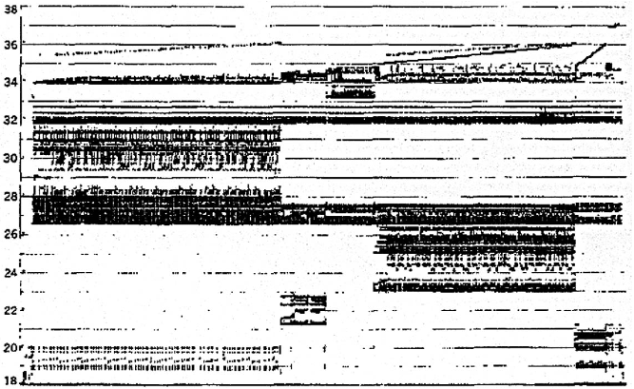
Real Memory Reference Patterns
Memory Address (one dot per access)
Donald J. Hatfield, Jeanette Gerald: Program Restructuring for Virtual Memory. IBM Systems Journal 10(3): 168-192 (1971)
Time

Slide 83
Memory Reference Patterns
Temporal
Locality
Memory Address (one dot per access)
Spatial
Locality
Time
Donald J. Hatfield, Jeanette Gerald: Program Restructuring for Virtual Memory. IBM Systems Journal 10(3): 168-192 (1971)

Slide 84
Two predictable properties of memory references:局部性
Temporal Locality: If a location is referenced it is likely to be referenced again in the near future.
Spatial Locality: If a location is referenced it is likely that locations near it will be referenced in the near future.

Slide 85
What to Do About Locality局部性
Temporal Locality
If a memory location is referenced then it will tend to be referenced again soon
⇒ Keep most recently accessed data items closer to the processor
Spatial Locality
If a memory location is referenced, the locations with nearby addresses will tend to be referenced soon
⇒ Move blocks consisting of contiguous words closer to the processor
Notes:
How does the memory hierarchy work? Well it is rather simple, at least in principle.
In order to take advantage of the temporal locality, that is the locality in time, the memory hierarchy will keep those more recently accessed data items closer to the processor because chances are (points to the principle), the processor will access them again soon.
In order to take advantage of the spatial locality, not ONLY do we move the item that has just been accessed to the upper level, but we ALSO move the data items that are adjacent to it.

Slide 86
Cache in a Computer
Processor
Memory
Input
Enable?
Read/Write
Control
Program
Datapath
Cache
Memory (including
cache) organized around blocks, which are typically multiple words
Address
Bytes
PC
Registers
Write Data
Data
Arithmetic & Logic Unit
(ALU)
ReadData
Output
Processor organized around words and bytes
Processor-Memory Interface
I/O-Memory Interfaces

Slide 87
Direct-Mapped Cache (1/4)
In a direct-mapped cache, each memory address is associated with one possible block within the cache
Therefore, we only need to look in a single location in the cache for the data if it exists in the cache
Block is the unit of transfer between cache and memory

Slide 88
One More Detail: Valid Bit
When start a new program, cache does not have valid information for this program
Need an indicator whether this tag entry is valid for this program
Add a “valid bit” to the cache tag entry
0 => cache miss, even if by chance, address = tag
1 => cache hit, if processor address = tag

Slide 89
Multiword-Block Direct-Mapped Cache
Four words/block, cache size = 4K words
Byte offset
Hit
31 30 . . . 15 14 13 . . . 4 3 2 1 0
Data
Tag
18
10
Block offset
Index
Index
Valid
Tag
Data
0
1
2
.
.
.
1021
1022
1023
18
2
“MUX” 4→1 Multiplexor
AND
32
What kind of locality are we taking advantage of?
Notes:
to take advantage for spatial locality want a cache block that is larger than word word in size.

Slide 90
Types of Cache Misses (1/2)
“Three Cs” Model of Misses
1st C: Compulsory强制的Misses
occur when a program is first started
cache does not contain any of that program’s data yet, so misses are bound to occur
can’t be avoided easily, so won’t focus on these in this course
Every block of memory will have one compulsory miss (NOT only every block of the cache)

Slide 91
Types of Cache Misses (2/2)
2nd C: Conflict Misses
miss that occurs because two distinct memory addresses map to the same cache location
two blocks (which happen to map to the same location) can keep overwriting each other
big problem in direct-mapped caches
how do we lessen the effect of these?
Dealing with Conflict Misses
Solution 1: Make the cache size bigger
Fails at some point
Solution 2: Multiple distinct blocks can fit in the same cache Index?

Slide 92
Fully Associative Cache (1/3)
Memory address fields:
Tag: same as before
Offset: same as before
Index: non-existant
What does this mean?
no “rows”: any block can go anywhere in the cache
must compare with all tags in entire cache to see if data is there

Slide 93
Fully Associative Cache (2/3)
Fully Associative Cache (e.g., 32 B block)
compare tags in parallel
31
4
0
Cache Tag (27 bits long)
Byte Offset
Cache Tag
Valid
Cache Data
=
B 31
:
B 1
B 0
=
=
=
:
:
:
:
=

Slide 94
Final Type of Cache Miss
3rd C: Capacity Misses
miss that occurs because the cache has a limited size
miss that would not occur if we increase the size of the cache
sketchy definition, so just get the general idea
This is the primary type of miss for Fully Associative caches.

Slide 95
N-Way Set Associative关联Cache (1/3)
Memory address fields:
Tag: same as before
Offset: same as before
Index: points us to the correct “row” (called a set in this case)
So what’s the difference?
each set contains multiple blocks
once we’ve found correct set, must compare with all tags in that set to find our data
Size of $ is # of sets x N blocks x block size

Slide 96
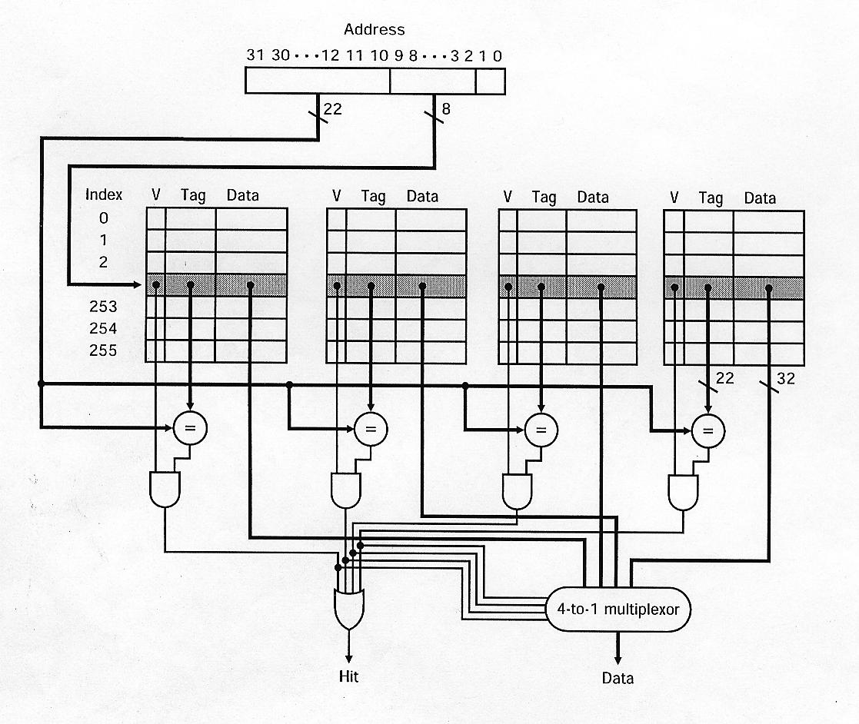
4-Way Set Associative Cache Circuit
tag
index
“One Hot” Encoding

Slide 97
Block Replacement Policy
Direct-Mapped Cache
index completely specifies position which position a block can go in on a miss
N-Way Set Assoc
index specifies a set, but block can occupy any position within the set on a miss
Fully Associative
block can be written into any position
Question: if we have the choice, where should we write an incoming block?
If there’s a valid bit off, write new block into first invalid.
If all are valid, pick a replacement policy
rule for which block gets “cached out” on a miss.

Slide 98
Block Replacement Policy
LRU (Least Recently Used)最近最少使用
Idea: cache out block which has been accessed (read or write) least recently
Pro: temporal locality ➔ recent past use implies likely future use: in fact, this is a very effective policy
Con: with 2-way set assoc, easy to keep track (one LRU bit); with 4-way or greater, requires complicated hardware and much time to keep track of this
FIFO
Idea: ignores accesses, just tracks initial order
Random
If low temporal locality of workload, works ok

Slide 99
Improving Miss Penalty
When caches first became popular, Miss Penalty ~ 10 processor clock cycles
Today 2.4 GHz Processor (0.4 ns per clock cycle) and 80 ns to go to DRAM  200 processor clock cycles!
MEM
DRAM
Proc
$
$₂
Solution: another cache between memory and the processor cache: Second Level (L2) Cache

Slide 100
Analyzing Multi-level cache hierarchy
DRAM
Proc
$
$₂
L1 hit
time
L2 hit
time
L2 Miss Rate
L2 Miss Penalty
L1 Miss Rate
L1 Miss Penalty
Avg Mem Access Time =
L1 Hit Time + L1 Miss Rate * L1 Miss Penalty
L1 Miss Penalty =
L2 Hit Time + L2 Miss Rate * L2 Miss Penalty
Avg Mem Access Time =
L1 Hit Time + L1 Miss Rate * (L2 Hit Time + L2 Miss Rate * L2 Miss Penalty)

Slide 101
Example: with L2 cache
Assume
L1 Hit Time = 1 cycle
L1 Miss rate = 5%
L2 Hit Time = 5 cycles
L2 Miss rate = 15% (% L1 misses that miss)
L2 Miss Penalty = 200 cycles
L1 miss penalty = 5 + 0.15 * 200 = 35
Avg mem access time = 1 + 0.05 x 35 = 2.75 cycles

Slide 102
Kilo, Mega, Giga, Tera, Peta, Exa, Zetta, Yotta
Name | Abbr | Factor | SI size
Kilo | K | 2¹⁰ = 1,024 | 10³ = 1,000
Mega | M | 2²⁰ = 1,048,576 | 10⁶ = 1,000,000
Giga | G | 2³⁰ = 1,073,741,824 | 10⁹ = 1,000,000,000
Tera | T | 2⁴⁰ = 1,099,511,627,776 | 10¹² = 1,000,000,000,000
Peta | P | 2⁵⁰ = 1,125,899,906,842,624 | 10¹⁵ = 1,000,000,000,000,000
Exa | E | 2⁶⁰ = 1,152,921,504,606,846,976 | 10¹⁸ = 1,000,000,000,000,000,000
Zetta | Z | 2⁷⁰ = 1,180,591,620,717,411,303,424 | 10²¹ = 1,000,000,000,000,000,000,000
Yotta | Y | 2⁸⁰ = 1,208,925,819,614,629,174,706,176 | 10²⁴ = 1,000,000,000,000,000,000,000,000
Common use prefixes (all SI, except K [= k in SI])
Confusing! Common usage of “kilobyte” means 1024 bytes, but the “correct” SI value is 1000 bytes
Hard Disk manufacturers & Telecommunications are the only computing groups that use SI factors
What is advertised as a 1 TB drive actually holds about 90% of what you expect
A 1 Mbit/s connection transfers 10⁶ bps.

Slide 103
Recap
We’ve discussed memory caching in detail. Caching in general shows up over and over in computer systems
Filesystem cache, Web page cache, Game databases / tablebases, Software memoization, Others?
Big idea: if something is expensive but we want to do it repeatedly, do it once and cache the result.
Cache design choices:
Size of cache: speed v. capacity
Block size (i.e., cache aspect ratio)
Write Policy (Write through v. write back
Associativity choice of N (direct-mapped v. set v. fully associative)
Block replacement policy
2nd level cache?
3rd level cache?
Use performance model to pick between choices, depending on programs, technology, budget, ...

Slide 104
Cache

Slide 105
Cache Terminology
Block – Minimum unit of information transfer between levels of the hierarchy
Block addressing varies by technology at each level
Blocks are moved one level at a time
Hit – Data appears in a block in lower numbered level
Hit rate – Percent of accesses found
Hit time – Time to access at lower nuumbered level
Hit time = Cache access time + Time to determine hit/miss
Miss – Data was not in lower numbered level and had to be fetched from a higher numbered level
Miss rate – Percent of misses (1 – Hit rate)
Miss penalty – Overhead in getting data from a higher numbered level
Miss penalty = higher level access time + Time to deliver to lower level + Cache replacement/forward to processor time
Miss penalty is usually much larger than the hit time

Slide 106
Associative Cache Example

Slide 107
A Typical Memory Hierarchy
Split instruction & data primary caches
(on-chip SRAM)
Multiple interleaved memory banks
(off-chip DRAM)
L1
Instruction Cache
Unified L2 Cache
Memory
CPU
Memory
L1 Data Cache
Memory
RF
Memory
Multiported register file (part of CPU)
Large unified secondary cache (on-chip SRAM)
Notes:
Implementation close to the CPU looks like a Harvard machine.

Slide 108
Direct-Mapped Cache
Tag
Index
Block
Offset
t
k
b
V
Tag
Data Block
2^{k}
lines
t
=
HIT
Data Word or Byte

Slide 109
2-Way Set-Associative Cache
Tag
Index
Block
Offset
b
t
k
V
Tag
Data Block
V
Tag
Data Block
t
=
=
Data
Word
or Byte
HIT
Notes:
Compare latency to direct mapped case?

Slide 110
Fully Associative Cache
V
Tag
Data Block
t
=
Tag
t
=
HIT
Block
Offset
Data
Word
or Byte
=
b

Slide 111
Causes for Cache Misses
Compulsory: first-reference to a block a.k.a. cold start misses
- misses that would occur even with infinite cache
Capacity: cache is too small to hold all data needed by the program
- misses that would occur even under perfect
replacement policy
Conflict: misses that occur because of collisions
due to block-placement strategy
misses that would not occur with full associativity
Coherence

Slide 112
Lecture 10
Virtual Memory

Slide 113
Bare Machine原始机
PC
Physical Address
D
E
M
Physical Address
W
Inst. Cache
Decode
Data Cache
+
Memory Controller
Physical Address
Physical Address
Physical Address
Main Memory (DRAM)
In a bare machine, the only kind of address is a physical address, corresponding to address lines of actual hardware memory.

Slide 114
Dynamic Address Translation
Motivation
In early machines, I/O was slow and each I/O transfer involved the CPU (programmed I/O)
Higher throughput possible if CPU and I/O of 2 or more programs were overlapped, how?
→ multiprogramming with DMA I/O devices, interrupts
Location-independent programs
Programming and storage management ease
→ need for a base register
Protection
Independent programs should not affect each other inadvertently
→ need for a bound register
Multiprogramming drives requirement for resident supervisor software to manage context switches between multiple programs
Program 1
Physical Memory
Program 2
OS

Slide 115
Motivation #1: Large Address Space for Each Executing Program
Each program thinks it has a ~2³² byte address space of its own
May not use it all though
Available main memory may be much smaller

Slide 116
Simple Base and Bound Translation
Segment Length
Bound
Register
≥
Bounds
Violation?
Logical
Address
Physical
Address
Current
Segment
Physical Memory
Load X
+
Base
Register
Base Physical Address
Program Address Space
Base and bounds registers are visible/accessible only when processor is running in the supervisor mode

Slide 117
Separate Areas for Program and Data
(Scheme used on all Cray vector supercomputers prior to X1, 2002)
Data Bound Register
Bounds Violation?
≥
Logical Address
Data Segment
Load X
Data Base Register
+
Physical Address
Physical Memory
Program Address Space
Program Bound Register
≥
Bounds Violation?
Program Counter
Logical Address
Program Segment
Program Base Register
+
Physical Address
What is an advantage of this separation?
What about more base/bound pairs?
Notes:
Permits sharing of program segments.

Slide 118
Base and Bound约束Machine
Program Bound Register
Data Bound Register
Bounds Violation?
Bounds Violation?
≥
≥
Logical Address
Logical Address
PC
D
Decode
E
M
W
Inst. Cache
Data Cache
+
+
+
Physical Address
Physical Address
Program Base Register
Data Base Register
Physical Address
Physical Address
Memory Controller
Physical Address
Main Memory (DRAM)
Can fold addition of base register into (register+immediate) address calculation using a carry-save adder (sums three numbers with only a few gate delays more than adding two numbers)

Slide 119
Paged Memory Systems
Program-generated (virtual or logical) address split into:
Page Number
Offset
Page Table contains physical address of start of each fixed-sized page in virtual address space
1
0
0
1
1
0
Physical Memory
Pages
2
2
3
3
Virtual Address Space Pages for Job 1
Page Table
for Job 1
3
2
Paging makes it possible to store a large contiguous virtual memory space using non-contiguous physical memory pages
Notes:
Relaxes the contiguous allocation requirement.

Slide 120
Private Address Space per User
1
0
0
1
1
0
2
2
3
3
1
Virtual Address Space Pages for Job 1
Page Table
for Job 1
3
3
Physical Memory
Pages
3
2
0
0
1
1
2
2
0
3
3
0
Virtual Address Space Pages for Job 2
Page Table
for Job 2
2
2
0
0
1
1
1
2
2
3
3
Operating
Virtual Address Space Pages for Job 3
Page Table
for Job 3
System
Pages
Notes:
Relaxes the contiguous allocation requirement.

Slide 121
Page Tables Live in Memory
Physical Memory
Pages
1
0
Simple linear page tables are too large, so hierarchical page tables are commonly used (see later)
1
3
3
0
1
2
2
3
0
Virtual Address Space Pages for Job 2
2
Common for modern OS to place page tables in kernel’s virtual memory (page tables can be swapped to secondary storage)
0
Page Table
1
for Job 2
2
3
Virtual Address Space Pages for Job 1
Page Table
for Job 1
Notes:
Relaxes the contiguous allocation requirement.

Slide 122
What Does the OS do?
OS is the (first) thing that runs when computer starts
Finds and controls all devices in the machine in a general way
Relying on hardware specific “device drivers”
Starts services (100+)
File system,
Network stack (Ethernet, WiFi, Bluetooth, …),
TTY (keyboard),
…
Loads, runs and manages programs:
Multiple programs at the same time (time-sharing)
Isolate programs from each other (isolation)
Multiplex resources between applications (e.g., devices)

Slide 123
Supervisor Mode监管者模式
If something goes wrong in an application, it could crash the entire machine. And what about malware恶意代码, etc.?
The OS enforces resource constraints to applications (e.g., access to memory, devices)
To help protect the OS from the application, CPUs have a supervisor mode (e.g., set by a status bit in a special register)
A process can only access a subset of instructions and (physical) memory when not in supervisor mode (user mode)
Process can change out of supervisor mode using a special instruction, but not into it directly – only using an interrupt
Supervisory mode is a bit like “superuser”
But used much more sparingly (most of OS code does not run in supervisory mode)
Errors in supervisory mode often catastrophic (blue “screen of death”, or “I just corrupted your disk”)

Slide 124
Syscalls
What if we want to call an OS routine? E.g.,
to read a file,
launch a new process,
ask for more memory (malloc),
send data, etc.
Need to perform a syscall:
Set up function arguments in registers,
Raise software interrupt (with special assembly instruction)
OS will perform the operation and return to user mode
This way, the OS can mediate access to all resources, and devices

Slide 125
Multiprogramming
The OS runs multiple applications at the same time
But not really (unless you have a core per process)
Switches between processes very quickly (on human time scale) – this is called a “context switch”
When jumping into process, set timer (we will call this ‘interrupt’)
When it expires, store PC, registers, etc. (process state)
Pick a different process to run and load its state
Set timer, change to user mode, jump to the new PC
Deciding what process to run is called scheduling

Slide 126
Protection, Translation, Paging
Supervisor mode alone is not sufficient to fully isolate applications from each other or from the OS
Application could overwrite another application’s memory.
Typically programs start at some fixed address, e.g. 0x8FFFFFFF
How can 100’s of programs share memory at location 0x8FFFFFFF?
Also, may want to address more memory than we actually have (e.g., for sparse data structures)
Solution: Virtual Memory
Gives each process the illusion of a full memory address space that it has completely for itself

Slide 127
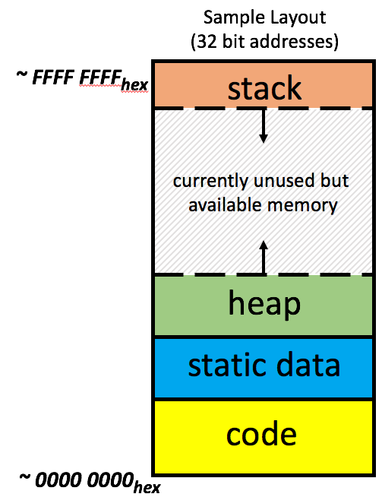
Virtual vs. Physical Addresses
Processor (& Caches)
?
Memory (DRAM)
Control
Datapath
Physical Address
PC
Virtual Address
Bytes
Registers
(ALU)
Many of these (software & hardware cores)
One main memory
Processes use virtual addresses, e.g., 0 … 0xffff,ffff
Many processes, all using same (conflicting) addresses
Memory uses physical addresses (also, e.g., 0 ... 0xffff,ffff)
Memory manager maps virtual to physical addresses

Slide 128
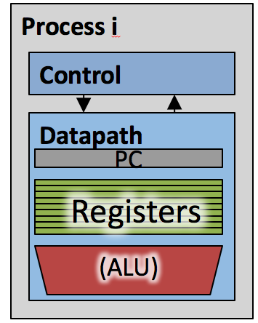
Paged Memory
Memory (DRAM)
Page Table
Page N
Page 2
Page 1
Page 0
Page Table
Page Table
Each process has a dedicated page table. Physical memory non-consecutive.

Slide 129
Paged Memory Address Translation
OS keeps track of which process is active
Chooses correct page table
Memory manager extracts page number from virtual address
e.g. just top 20 bits
Looks up page address in page table
Computes physical memory address from sum of
Page address and
Offset (from virtual address)
Virtual address (e.g. 32 Bits)
page table entry | offset
Physical address
page number | offset
Physical addresses may (but do not have to) have more or fewer bits than virtual addresses

Slide 130
Paged Table Storage in DRAM
Memory (DRAM)
Page Table
Page Table
Page
Page Table
lw/sw take two memory references

Slide 131
Memory Access
Check page table entry:
Valid?
Yes, valid → In DRAM?
Yes, in DRAM: read/write data
No, on disk: allocate new page in DRAM
If out of memory, evict a page from DRAM
Store evicted page to disk
Read page from disk into memory
Read/write data
Not Valid
allocate new page in DRAM
If out of memory, evict a page
Read/write data
Page fault
OS intervention

Slide 132
Hierarchical Page Table
Exploits Sparsity of Virtual Address Space Use
Virtual Address
31
22
21
12
11
0
p1 p2 offset
10-bit
L1 index
10-bit
L2 index
Root of the Current
Page Table
Physical Memory
p2
p1
(Processor Register)
Level 1
Page Table
Page size 10b → 1024 x 4096B
Supervisor page table base register (SPTBR) in RISC-V
Level 2
Page Tables
12b → 4096B
page in primary memory (DRAM)
page in secondary memory (disk)
PTE of a nonexistent page
Data Pages

Slide 133
Translation Lookaside Buffers (TLB转换快表)
Address translation is very expensive!
In a single-level page table, each reference becomes two memory accesses
In a two-level page table, each reference becomes three memory accesses
Solution: Cache some translations in TLB
TLB hit → Single-Cycle Translation
TLB miss → Page-Table Walk to refill
virtual address
VPN offset
(VPN = virtual page number)
V D tag PPN
(PPN = physical page number)
hit?
physical address
PPN offset
Notes:
3 memory references
V – valid
R – referenced (know what to evict from cache)
R –
D – dirty (page was written to)

Slide 134
Where Are TLBs Located?
Which should we check first: Cache or TLB?
Can cache hold requested data if corresponding page is not in physical memory?
With TLB first, does cache receive VA or PA?
No
PA
hit
miss
CPU
TLB
Cache
Main Memory
VA
PA
data
miss
hit
Page Table
Notice that it is now the TLB that does translation, not the Page Table!

Slide 135
Address Translation Using TLB
VPN
TLB Tag
TLB Index
Page Offset
Virtual Address
TLB
TLB Tag | PPN
(used just like in a cache)
. . .
PA split two different ways!
PPN
Page Offset
Physical Address
Data Cache
 | Tag | Block Data
. . .
Tag
Index
Offset
Note: TIO for VA & PA unrelated

Slide 136
VM-related Events in Pipeline
PC
Inst TLB
Inst. Cache
D
Decode
E
M
Data TLB
Data Cache
W
+
TLB miss? Page Fault?
Protection violation?
TLB miss? Page Fault?
Protection violation?
Handling a TLB miss needs a hardware or software mechanism to refill TLB
Usually done in hardware
Protection violation may abort process

Slide 137
Page-Based Virtual-Memory Machine (Hardware Page-Table Walk)
Page Fault?
Protection violation?
Page Fault?
Protection violation?
Virtual Address
Virtual Address
Physical Address
Physical Address
PC
Inst. TLB
D
Decode
E
M
Data TLB
W
Inst. Cache
Data Cache
+
Miss?
Miss?
Page-Table Base Register
Hardware Page Table Walker
Physical Address
Memory Controller
Physical Address
Physical Address
Main Memory (DRAM)
Assumes page tables held in untranslated physical memory

Slide 138
Address Translation: putting it all together
Virtual Address
hardware
hardware or software
software
TLB
Lookup
miss
hit
Page Table
Walk
Protection
Check
the page is
∉ memory ∈ memory
denied
permitted
Page Fault
(OS loads page)
Update TLB
Protection
Fault
Physical
Address
(to cache)
Where?
SEGFAULT
Notes:
Need to restart instruction.
Soft and hard page faults.

Slide 139
Impact of Paging on AMAT (1/2)
Memory Parameters:
L1 cache hit = 1 clock cycles, hit 95% of accesses
L2 cache hit = 10 clock cycles, hit 60% of L1 misses
DRAM = 200 clock cycles (≈100 nanoseconds)
Disk = 20,000,000 clock cycles (≈10 milliseconds)
Average Memory Access Time (no paging):
1 + 5%×10 + 5%×40%×200 = 5.5 clock cycles
Average Memory Access Time (with paging):
5.5 (AMAT with no paging) + ?

Slide 140
Memory Mapped I/O
Certain addresses are not regular memory
Instead, they correspond to registers in I/O devices
address
0x00000000
Memory-mapped
0x7FFFFFFF
ctrl reg.
0x8000000
data reg.
Program & Data Memory
0xFFFFFFFF

Slide 141
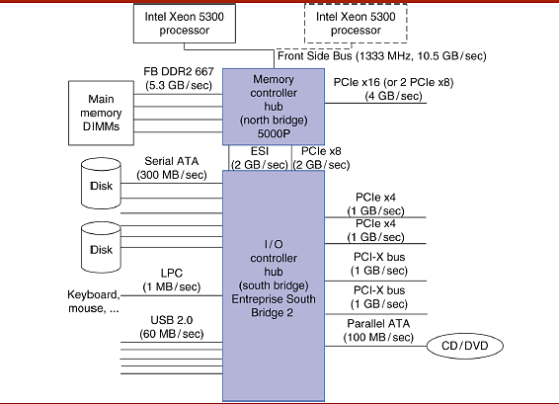
Review: Typical x86 PC I/O System

Slide 142
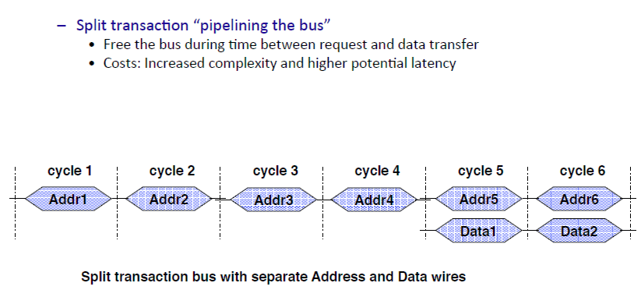
Increasing Bus Bandwidth

Slide 143
Communication with the CPU
Method #1: Polling轮询
I/O device places information in a status register
The OS periodically checks the status register
Whether polling is used dependent upon whether the device can initiate I/O independently
For instance, a mouse works well since it has a fixed I/O rate and initiates its own data (whenever it is moved)
For others, such as disk access, I/O only occurs under the control of the OS, so we poll only when the OS knows it is active
Advantages
Simple to implement
Processor is in control and does the work
Disadvantage
Polling overhead and data transfer consume CPU time

Slide 144
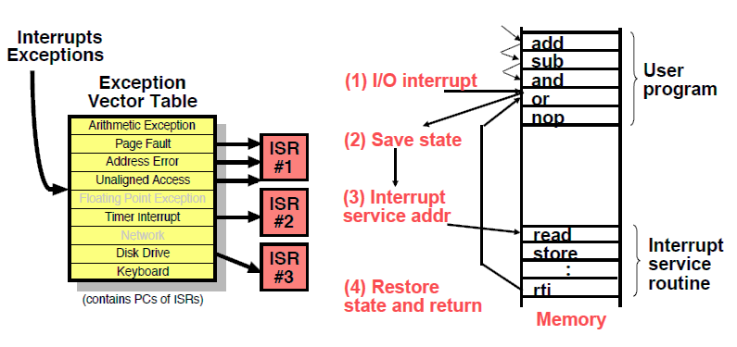
I/O Interrupts
中断服务程序
中断向量

Slide 145
Delegating授权委派I/O: DMA
Direct Memory Access (DMA)
Transfer blocks of data to or from memory without CPU intervention
Communication coordinated by the DMA controller
DMA controllers are integrated in memory or I/O controller chips
DMA controller acts as a bus master, in bus-based systems
DMA steps
Processor sets up DMA by supplying
Identify识别确定of the device and the operation (read/write)
The memory address for source/destination
The number of bytes to transfer
DMA controller starts the operation by arbitrating仲裁for the bus and then starting the transfer when the data is ready
Notify the processor when the DMA transfer is complete or on error
Usually using an interrupt

Slide 146
DMA & Coherence一致性
Solution 1: OS flushes冲刷the cache before I/O reads or forces write backs before I/O writes
Flush/write-back may involve selective addresses or whole cache
Can be done in software or with hardware (ISA) support
Solution 2: Route memory accesses for I/O through the cache
Search the cache for copies and invalidate or write-back as needed
This hardware solution may impact performance negatively消极地
While searching cache for I/O requests, it is not available to processor
Multi-level, inclusive包容性caches make this easier
Processor searches L1 cache mostly (until it misses)
I/O requests search L2 cache mostly *until it finds a copy of interest)

Slide 147
I/O Summary
I/O performance has to take into account many variables
Response time and throughput
CPU, memory, bus, I/O device
Workload e.g. transaction processing
I/O devices also span a wide spectrum
Disks, graphics, and networks
Buses
Bandwidth
Synchronization
Transactions
OS and I/O
Communication: Polling轮询and Interrupts
Handling I/O outside CPU: DMA

Slide 148
Lecture 11 Hardware Architectural Support for Operating System
148

Slide 149
Page-Based Virtual-Memory Machine (Hardware Page-Table Walk)
Page Fault?
Protection violation?
Page Fault?
Protection violation?
Virtual Address
Virtual Address
Physical Address
Physical Address
PC
Inst. TLB
D
Decode
E
M
Data TLB
W
Inst. Cache
Data Cache
+
Miss?
Miss?
Page-Table Base Register
Hardware Page Table Walker
Physical Address
Memory Controller
Physical Address
Physical Address
Main Memory (DRAM)
Assumes page tables held in untranslated physical memory
Notes:
CS252 S05
149

Slide 150
Processes进程
Definition: a process is an instance实例 of a running program
Process provides each program with two key abstractions
Logical control flow
Illusion of exclusive use of the processor
Private set of register values (including PC)
Private address space
Illusion of exclusive use of main memory of “infinite” size
How are these illusion错觉maintained?
Process execution is interleaved分时交错 (multitasking)
On available processors
Address space is managed by virtual memory system
专用的错觉
150

Slide 151
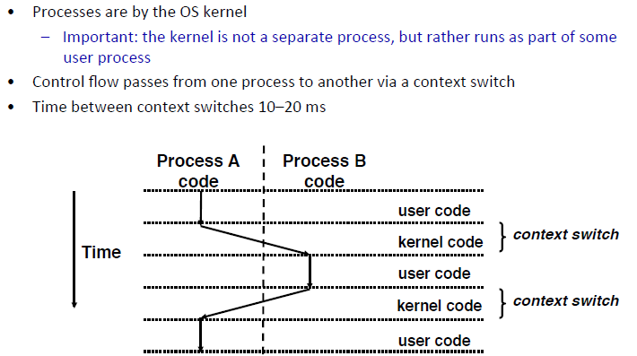
Supporting Concurrent Processes through Context Switching上下文切换
1
2
3
4
5
151

Slide 152
HW Support for the OS
Mechanisms机制 to protect OS from processes
Modes + virtual memory
Mechanisms to switch control flow between OS – processes
System calls + exceptions
Mechanisms to protect processes from each other
Virtual memory
Mechanisms to interact with I/O devices
Primarily memory-mapped I/O
152

Slide 153
Altering the Control Flow: System Calls
So far, we have branches and jumps
They implement control flows within a program
Expected switch to the OS: system call instruction (syscall)
A jump (or function call) to OS code
E.g., in order to perform a disk access
Also similar to a program-initiated exception
Switches processor to kernel mode & disables interrupts
Jump to a pre-defined place in the kernel
Returning from a syscall: use the eret instruction (privileged特殊的)
Switch to user mode & enable interrupts
Jump to program counter indicated by EPC
153

Slide 154
Altering the Control Flow: Exception & Interrupts
Exceptions & interrupts implement unexpected switch to OS
Exceptions: due to a problem in the program
E.g., divide by zero, illegal instructions, page fault
Interrupts: due to an external event
I/O event, hitting clt+c, periodic timer interrupt
Exceptions & interrupts operate similar to system calls
Set EPC & Cause registers
Switch to kernel mode, turn off interrupts
Jump to predefined part of the OS
Return to user program using eret instruction
154

Slide 155
Using Virtual Memory & Exceptions: Page Sharing
Example: Unix fork() system call
Creates a 2nd process which is a clone of the current one
How can we avoid copying all the address space
Expensive in time and space
Idea: share pages in physical memory
Each process gets a separate page table (separate virtual space)
But both PTs point to the same physical pages
Saves time and space on fork()
Same approach to support any type of sharing
Two processes running same program
Two processes that share data
creates a new process by duplicating the calling process
155

Slide 156
Lecture 11.2 SIMD-Parallel Data

Slide 157
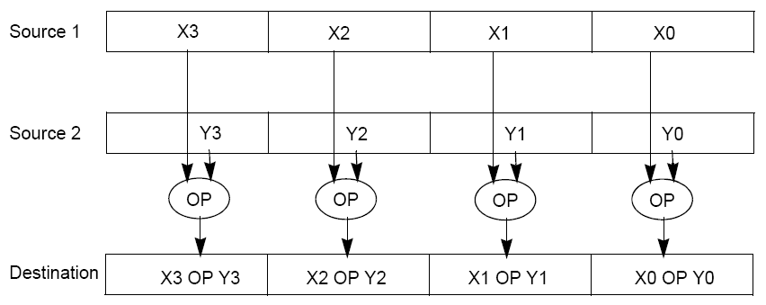
Back to RISC-V: Vector Extensions (Draft)
To improve performance, SIMD instructions (and hardware)
Fetch one instruction, do the work of multiple instructions
OP denotes a vector instruction, prefix v – vector register
vadd vd, vs1, vs2 (adds two vectors stored in vector registers)
Assume vectors are 512-bits wide

Slide 158
Summary
Flynn Taxonomy of Parallel Architectures
SIMD: Single Instruction Multiple Data
MIMD: Multiple Instruction Multiple Data
SISD: Single Instruction Single Data
MISD: Multiple Instruction Single Data (unused)
Intel AVX SIMD Instructions
One instruction fetch that operates on multiple operands simultaneously
512/256/128/64-bit AVX registers

Slide 159
Lecture 12 Thread-Level Parallel Processing
159

Slide 160
Machine Structures
Software Hardware
Parallel Requests
Assigned to computer
e.g., Search “Cats”
Parallel Threads
Assigned to core
e.g., Lookup, Ads
Parallel Instructions
>1 instruction @ one time
e.g., 5 pipelined instructions
Parallel Data
>1 data item @ one time
e.g., Add of 4 pairs of words
Hardware descriptions
All gates working in parallel at same time
Warehouse Scale Computer
Smart Phone
Harness Parallelism &
Achieve High Performance
Computer
Core
…
Core
Memory (Cache)
Input/Output
Core
Instruction Unit(s)
Functional
Unit(s)
A₀+B₀
A₁+B₁
A₂+B₂
A₃+B₃
Main Memory
Logic Gates

Slide 161
Multiprocessor Execution Model
Each processor (core) executes its own instructions
Separate resources (not shared)
Datapath (PC, registers, ALU)
Highest level caches (e.g., 1st and 2nd)
Shared resources
Memory (DRAM)
Often 3rd level cache
Often on same silicon chip
But not a requirement
Nomenclature
“Multiprocessor Microprocessor”
Multicore processor
E.g., four core CPU (central processing unit)
Executes four different instruction streams simultaneously

Slide 162
Multiprocessor Execution Model
Shared memory
Each “core” has access to the entire memory in the processor
Special hardware keeps caches consistent (next lecture!)
Advantages:
Simplifies communication in program via shared variables
Drawbacks:
Does not scale well:
“Slow” memory shared by many “customers” (cores)
May become bottleneck (Amdahl’s Law)
Two ways to use a multiprocessor:
Job-level parallelism
Processors work on unrelated problems
No communication between programs
Partition work of single task between several cores
E.g., each performs part of large matrix multiplication

Slide 163
Threads
Sequential flow of instructions that performs some task
Up to now we just called this a “program”
Each thread has:
Dedicated PC (program counter)
Separate registers
Accesses the shared memory
Each physical core provides one (or more)
Hardware threads that actively execute instructions
Each executes one “hardware thread”
Operating system multiplexes multiple
Software threads onto the available hardware threads
All threads except those mapped to hardware threads are waiting

Slide 164
Operating System Threads
Give illusion of many “simultaneously” active threads
Multiplex software threads onto hardware threads:
Switch out blocked threads (e.g., cache miss, user input, network access)
Timer (e.g., switch active thread every 1 ms)
Remove a software thread from a hardware thread by
Interrupting its execution
Saving its registers and PC to memory
Start executing a different software thread by
Loading its previously saved registers into a hardware thread’s registers
Jumping to its saved PC

Slide 165
Hardware Assisted Software Multithreading
Processor (1 Core, 2 Threads)
Memory
Input
Control
Datapath
PC 0
PC 1
Registers 0
Registers 1
(ALU)
Bytes
Two copies of PC and Registers inside processor hardware
Looks identical to two processors to software (hardware thread 0, hardware thread 1)
Hyperthreading:
Both threads can be active simultaneously
Output
I/O-Memory Interfaces

Slide 166
TLP
Thread Level Parallelism
Thread: sequence of instructions, with own program counter and processor state (e.g., register file)
Multicore:
Physical CPU: One thread (at a time) per CPU, in software OS switches threads typically in response to I/O events like disk read/write
Logical CPU: Fine-grain thread switching, in hardware, when thread blocks due to cache miss/memory access
Hyperthreading (aka Simultaneous Multithreading--SMT): Exploit superscalar architecture to launch instructions from different threads at the same time!

Slide 167
Parallel Programming Languages
Number of choices is indication of
No universal solution
Needs are very problem specific
E.g.,
Scientific computing/machine learning (matrix multiply)
Webserver: handle many unrelated requests simultaneously
Input / output: it’s all happening simultaneously!
Specialized languages for different tasks
Some are easier to use (for some problems)
None is particularly “easy” to use
COD
Parallel language examples for high-performance computing
OpenMP

Slide 168
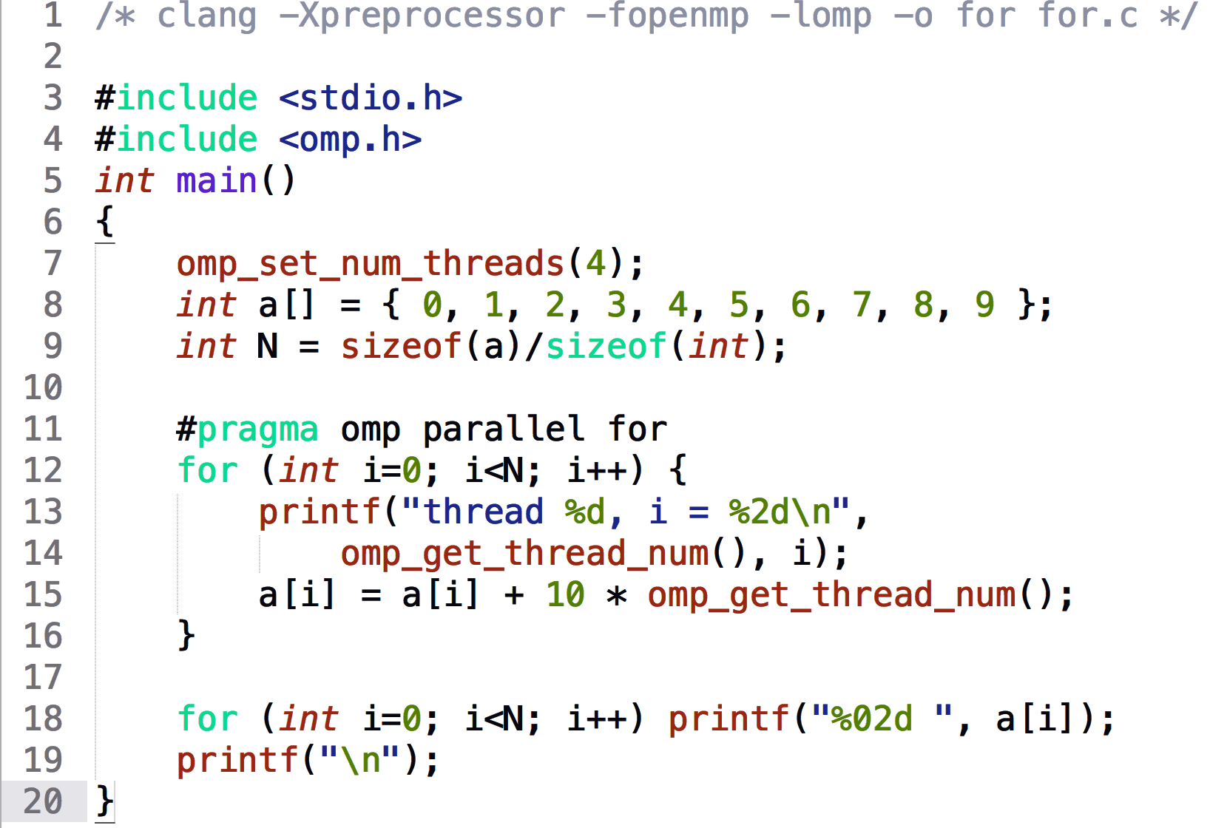
OpenMP Example
$ gcc-5 -fopenmp for.c;./a.out
% clang -Xpreprocessor -fopenmp -lomp -o for for.c; ./for
thread 0, i = 0
thread 1, i = 3
thread 2, i = 6
thread 3, i = 8
thread 0, i = 1
thread 1, i = 4
thread 2, i = 7
thread 3, i = 9
thread 0, i = 2
thread 1, i = 5
00 01 02 13 14 15 26 27 38 39
The call to find the maximum number of threads that are available to do work is omp_get_max_threads() (from omp.h).

Slide 169
Synchronization
Problem:
Limit access to shared resource to 1 actor at a time
E.g. only 1 person permitted to edit a file at a time
otherwise changes by several people get all mixed up
Solution:
Take turns:
Only one person get’s the microphone & talks at a time
Also good practice for classrooms, btw …

Slide 170
Locks
Computers use locks to control access to shared resources
Serves purpose of microphone in example
Also referred to as “semaphore”
Usually implemented with a variable
int lock;
0 for unlocked
1 for locked

Slide 171
Review: Data Races and Synchronization
Two memory accesses form a data race if from different threads access same location, at least one is a write, and they occur one after another
If there is a data race, result of program varies depending on chance (which thread first?)
Avoid data races by synchronizing writing and reading to get deterministic behavior
Synchronization done by user-level routines that rely on hardware synchronization instructions

Slide 172
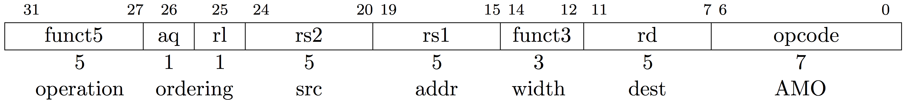
RISC-V Atomic Memory Operations (AMOs)
AMOs atomically perform an operation on an operand in memory and set the destination register to the original memory value
R-Type Instruction Format: Add, And, Or, Swap, Xor, Max, Max Unsigned, Min, Min Unsigned
amoadd.w rd,rs2,(rs1):
t = M[x[rs1]];
x[rd] = t; M[x[rs1]] = t + x[rs2]
Load from address in rs1 to “t”
rd = ”t”, i.e., the value in memory
Store at address in rs1 the calculation “t” <operation> rs2
aq(acquire) and rl(release) to insure in order execution

Slide 173
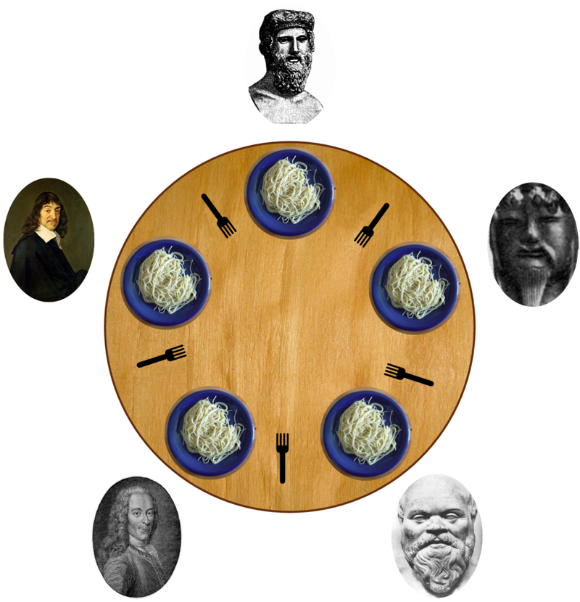
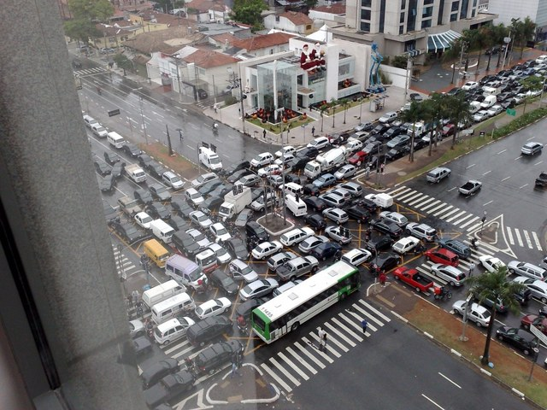
Deadlock
Deadlock: a system state in which no progress is possible
Dining Philosopher’s Problem:
Think until the left fork is available; when it is, pick it up
Think until the right fork is available; when it is, pick it up
When both forks are held, eat for a fixed amount of time
Then, put the right fork down
Then, put the left fork down
Repeat from the beginning
Solution?

Slide 174
Shared Memory Multiprocessor (SMP)
Q1 – Single address space shared by all processors/cores
Q2 – Processors coordinate/communicate through shared variables in memory (via loads and stores)
Use of shared data must be coordinated via synchronization primitives原型(locks) that allow access to data to only one processor at a time
All multicore computers today are SMP

Slide 175
Shared Memory and Caches
What if?
Processors 1 and 2 read Memory[1000] (value 20)
Processor
0
Processor
1000
Processor
1000
1
2
Cache
Cache
Cache
1000
1000
Interconnection Network
Memory
20
I/O
20

Slide 176
Keeping Multiple Caches Coherent
Architect’s job: shared memory ➔ keep cache values coherent
Idea: When any processor has cache miss or writes, notify other processors via interconnection network
If only reading, many processors can have copies
If a processor writes, invalidate any other copies
Write transactions from one processor, other caches “snoop” the common interconnect checking for tags they hold
Invalidate any copies of same address modified in other cache

Slide 177
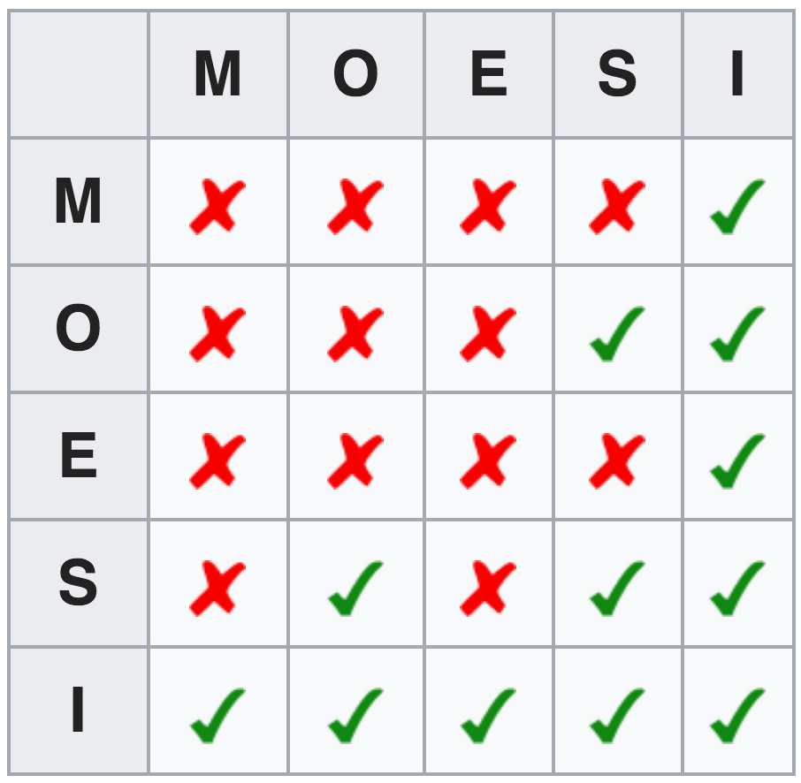

Name of Common Cache Coherency Protocol: MOESI
Memory access to cache is either
Modified (in cache)
Owned (in cache)
Exclusive (in cache)
Shared (in cache)
Invalid (not in cache)
Snooping/Snoopy Protocols
e.g., the Berkeley Ownership Protocol
See https://en.wikipedia.org/wiki/MOESI_protocol

Slide 178
Remember The 3Cs?
Compulsory强制的(cold start or process migration, 1st reference):
First access to block, impossible to avoid; small effect for long-running programs
Solution: increase block size (increases miss penalty; very large blocks could increase miss rate)
Capacity (not compulsory and…)：
Cache cannot contain all blocks accessed by the program even with perfect replacement policy in fully associative cache
Solution: increase cache size (may increase access time)
Conflict (not compulsory or capacity and…):
Multiple memory locations map to the same cache location
Solution 1: increase cache size
Solution 2: increase associativity (may increase access time)
Solution 3: improve replacement policy, e.g.. LRU
Notes:
(Capacity miss) That is the cache misses are due to the fact that the cache is simply not large enough to contain all the blocks that are accessed by the program.
The solution to reduce the Capacity miss rate is simple: increase the cache size.
Here is a summary of other types of cache miss we talked about.
First is the Compulsory misses. These are the misses that we cannot avoid. They are caused when we first start the program.
Then we talked about the conflict misses. They are the misses that caused by multiple memory locations being mapped to the same cache location.
There are two solutions to reduce conflict misses. The first one is, once again, increase the cache size. The second one is to increase the associativity.
For example, say using a 2-way set associative cache instead of directed mapped cache.
But keep in mind that cache miss rate is only one part of the equation. You also have to worry about cache access time and miss penalty. Do NOT optimize miss rate alone.
Finally, there is another source of cache miss we will not cover today. Those are referred to as invalidation misses caused by another process, such as IO , update the main memory so you have to flush the cache to avoid inconsistency between memory and cache.

Slide 179
Acknowledgements
These slides contain material from courses:
UCB CS152.
UCB CS61C.
Stanford EE108B

